Slide 1
Randomness Test Report
Yunxi Guo

Slide 2
Outline
(1) Signal retrieved from codebook
(2) Signal retrieved from MFCC
(3) Average of original signal
(4) Encoding average original signal

Slide 3
Retrieved From Codebook
For each codebook there are 16 centroids.
Each centroids composed by 20 parameters.
Convert each centroid to time domain and connected them together.
N = 3 moving average quantization.
16 x 20 = 320
C1 | C2 | C3 | C4
C1 |  |  |  |  | C2
…..
Average1
Average2
Average3

Slide 4
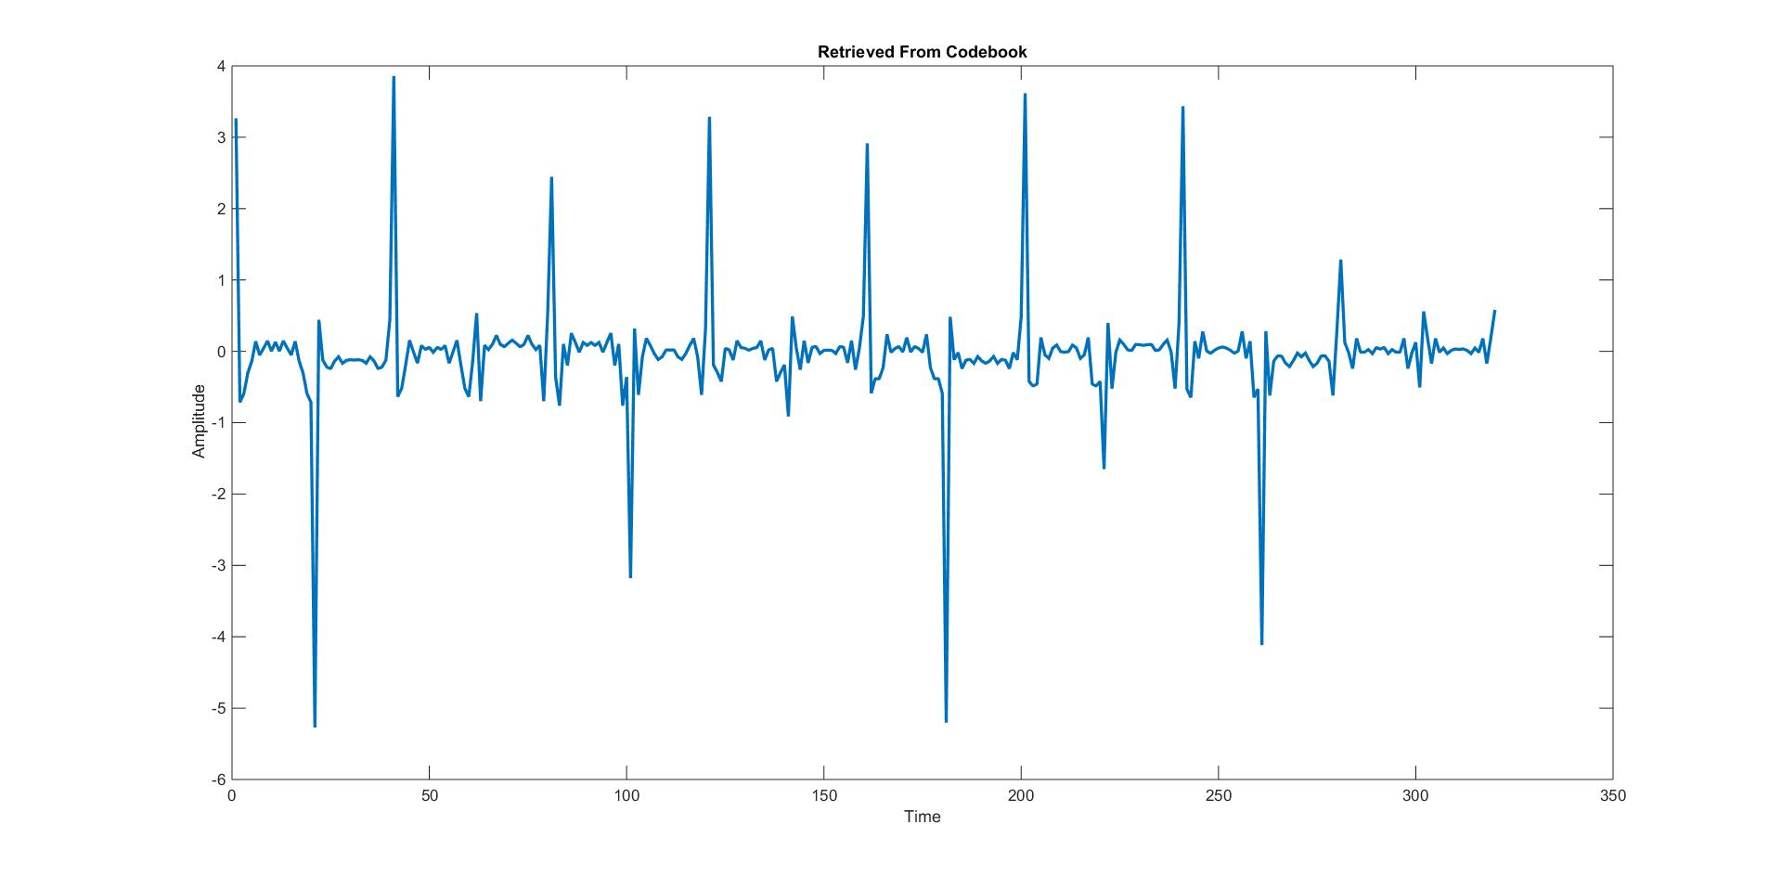
Back to Time Domain
An time domain result convert from codebook of User: Liang , Challenge: Zero Device: No.1

Slide 5
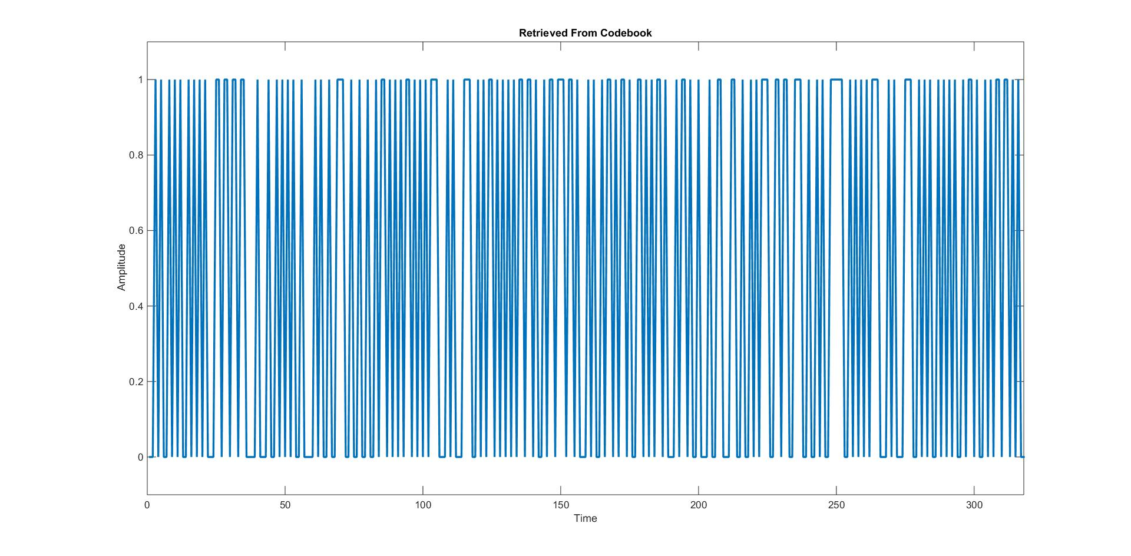
Encoding Result
Corresponding encoding result

Slide 6
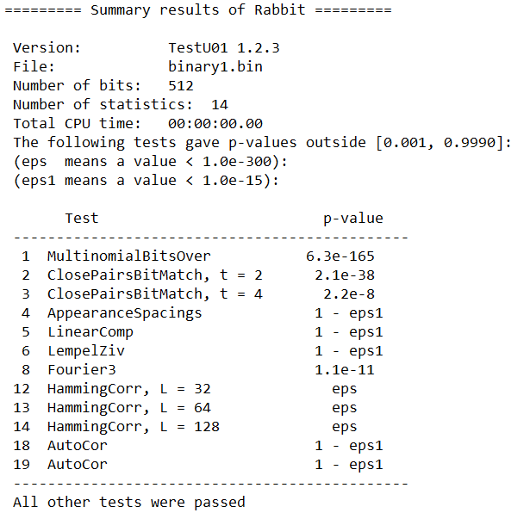
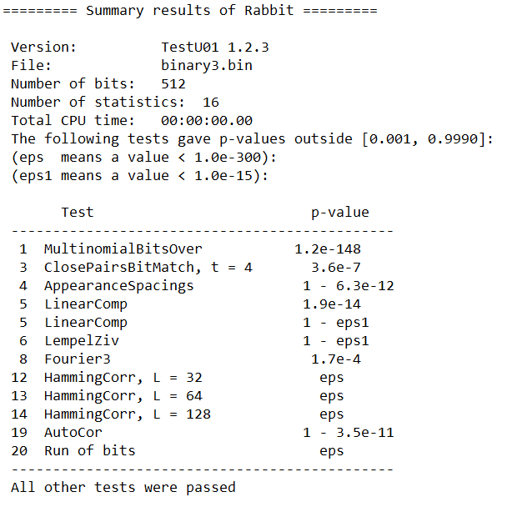
Randomness Test Result
For unquantized signal has 12 tests failed to past.
For quantized signal also has 12 test failed to past.

Slide 7
Analysis
Poor result caused by the nature of signal
(1) During time domain signal reconstruction:
Mel-frequency filter bank
Hamming window
Details removed by those filters can’t be recovered.
(2) The set of centroids can’t reflect the internal time sequence between frames.

Slide 8
Analysis
Poor result also caused by test process.
(1) Randomness test require at least 500 bits to operate.
Codebook only provide 320 bits.
I have took the first 2 less significant bits from each integer.
Ex.
1,0,1,1,1,0 -> 010001010100
All odd index bits are 0! Extremely bad.

Slide 9
Retrieved from MFCC
Convert each frame back to time domain
Connected each reconstructed time domain frame signal according to time sequence.
Do N = 3 moving average quantization.
Only take the least significant bit of integer: only valid information are kept.

Slide 10
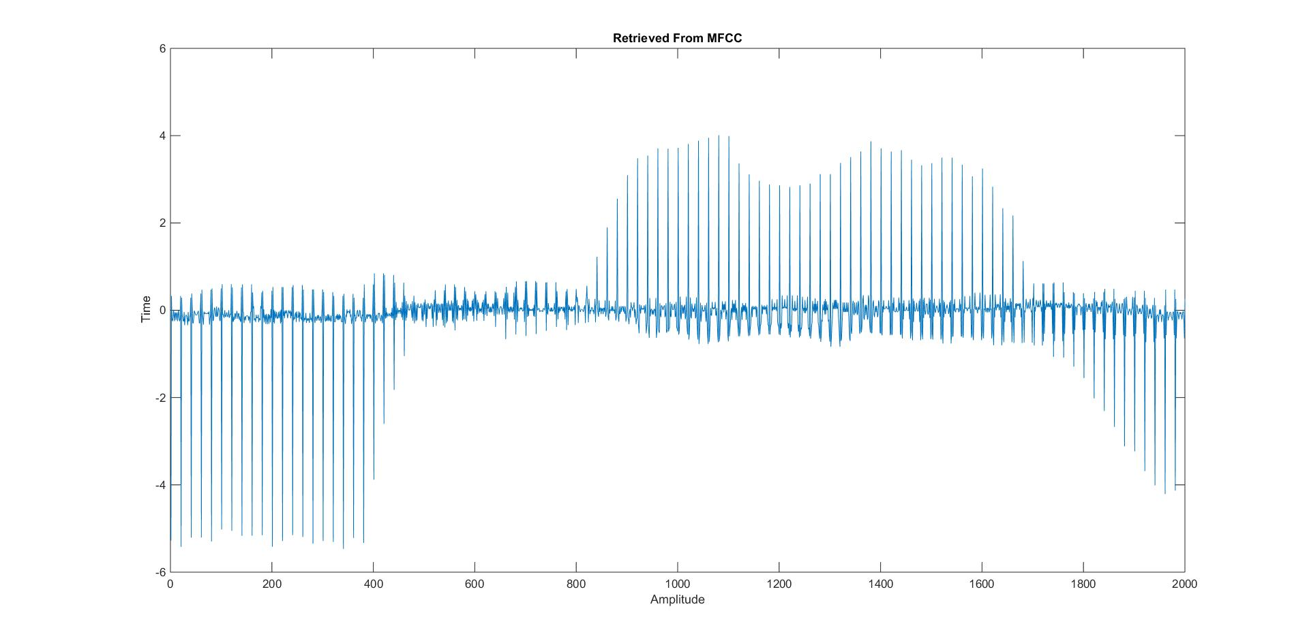
Back to Time Domain
An time domain result convert from MFCC of User: Liang , Challenge: Zero Device: No.1

Slide 11
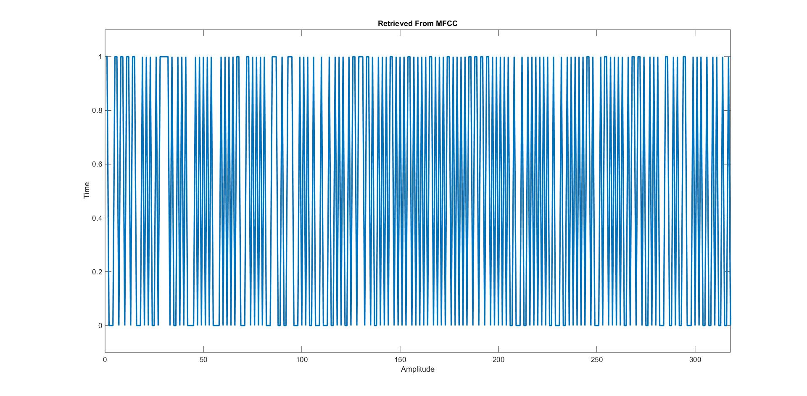
Encoding Result
Corresponding encoding result

Slide 12
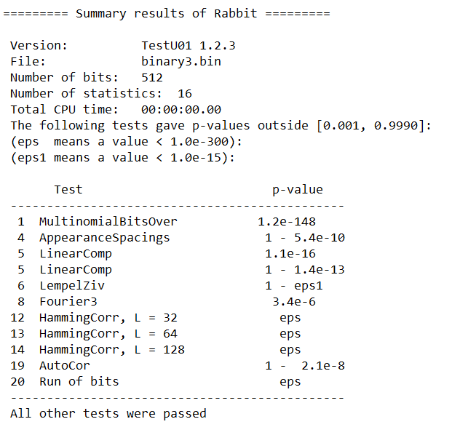
Randomness Test Result
Quantized signal has 11 tests failed to past.
“ClosePairsBitMatch” problem is solved.

Slide 13
Average of original signal
For all 50 training signals: average first several bits of them.
N=3 moving average for quantization.
…..
Average2
Shortest signal
Average1

Slide 14
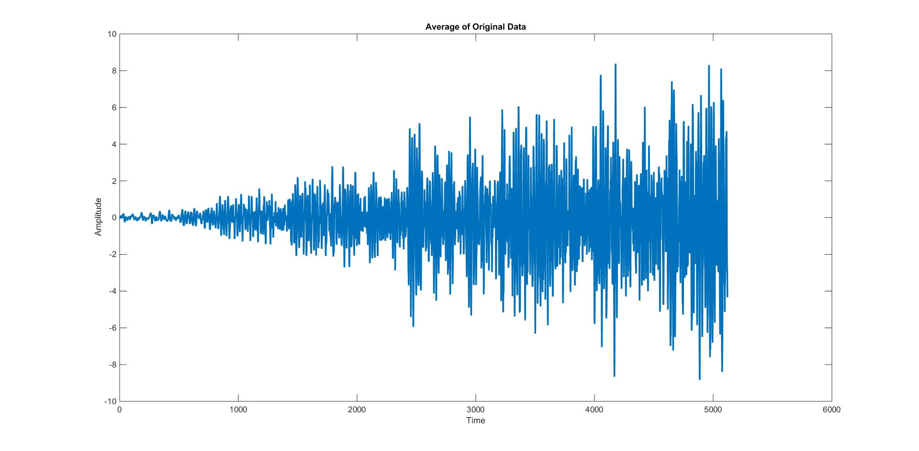
Averaging Result
Average result of User: Liang , Challenge: Zero Device: No.1

Slide 15
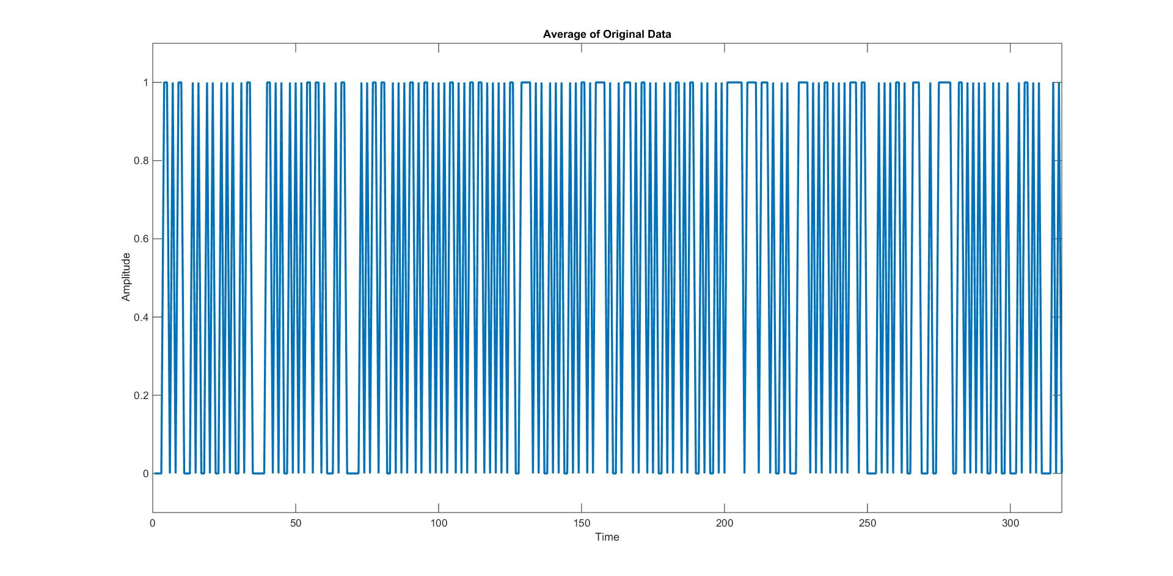
Encoding result
Corresponding encoding result

Slide 16
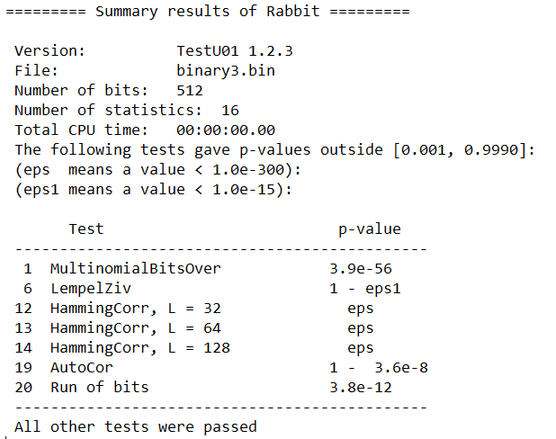
Randomness Test Result
Quantized signal has 7 tests failed to past.
Randomness greatly affected by hamming correlation.

Slide 17
AND Encoding
After apply N=3 moving average quantization on average original data, a sequence of (0,1) bits would be got.
Bit1
Bit801
Bit805
…..
…..
Offset=5
Bit1& Bit805 | Bit2& Bit806 | Bit3& Bit807 | Bit4& Bit808 | Bit5& Bit809
Result

Slide 18
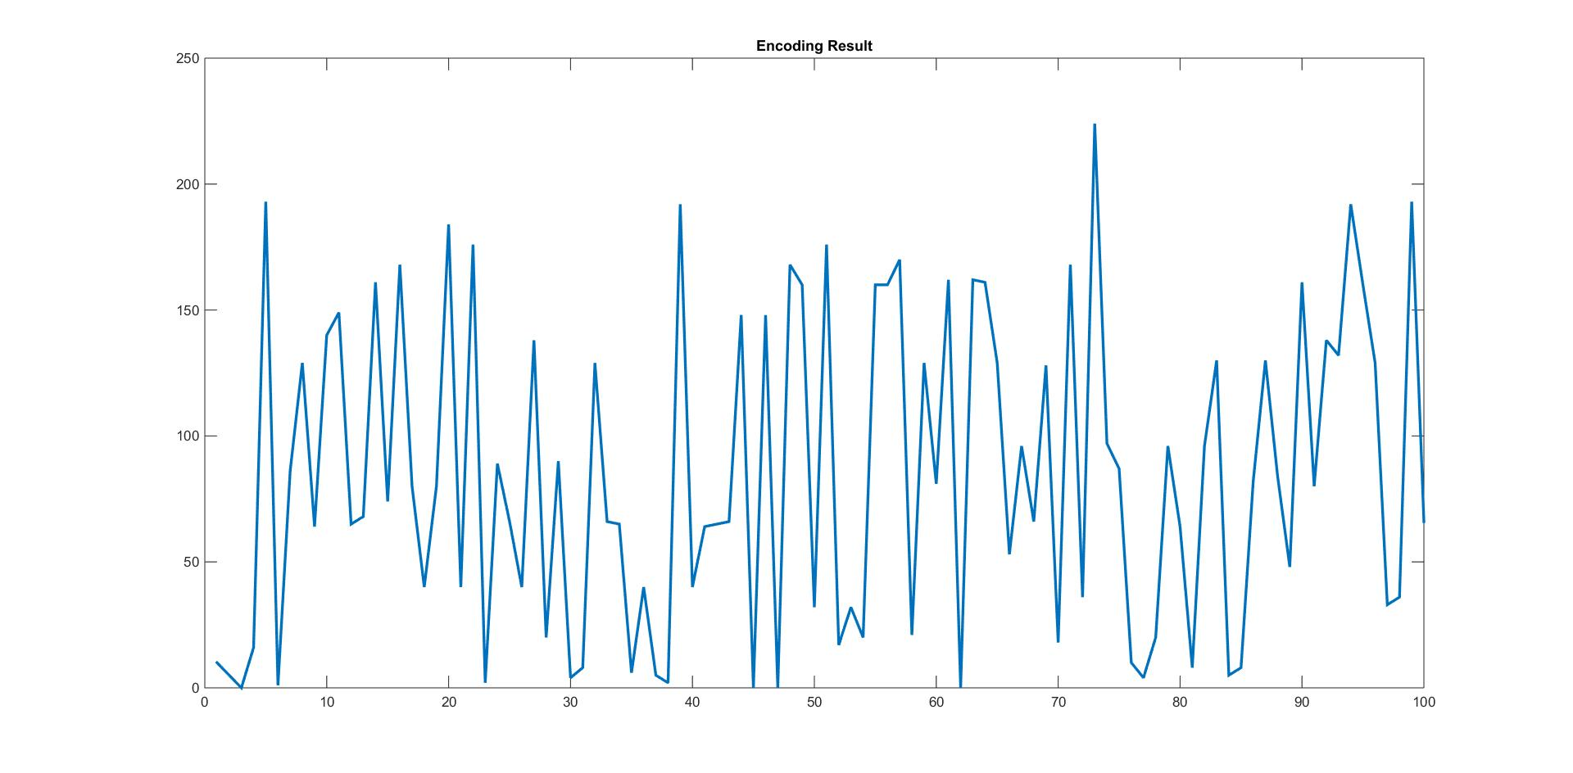
AND Encoding Result
Encoding result of User: Liang , Challenge: Zero Device: No.1

Slide 19
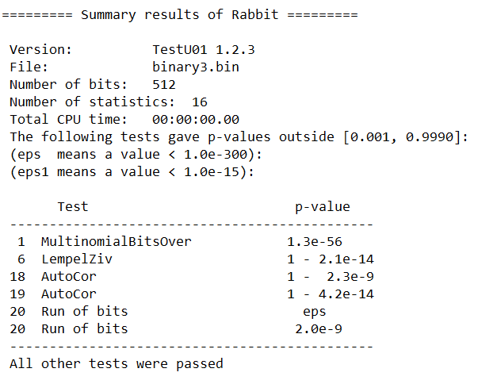
Randomness Test Result
Encoding signal has 6 tests failed to pass.
Best result!

Slide 20
Other Scheme I Tried
Remove header (“Liang_Zero_Device1”) from binary file : make no difference
N =5 moving average quantization: worse result
Apply 2 bytes mask on every 2 bytes: worse result
Quantize each sample and XOR each bit of all samples : worse result

Slide 21
Questions?

